Slide 1
Topic Recommender System
July 2020 ML-Team 6

Slide 2

ML July Team-6
Project Lead: Anshu Singh
PM Lead: Zoey Vu
Mentor: Sai Likhith
PM Task Lead: Aseem Sangalay
Participants: McCarthy Nolan, Samarth Shah, Justin Ngo, Mandar Mhaske, Priyanka Shah, Nikhil Bhutani, Urvi Chaudhary, Ananya V Kumar, Sanik Malepati, Ethan Lee
Observers: Emma Mantel, Kaylyn Phan, Rohit Roy

Slide 3
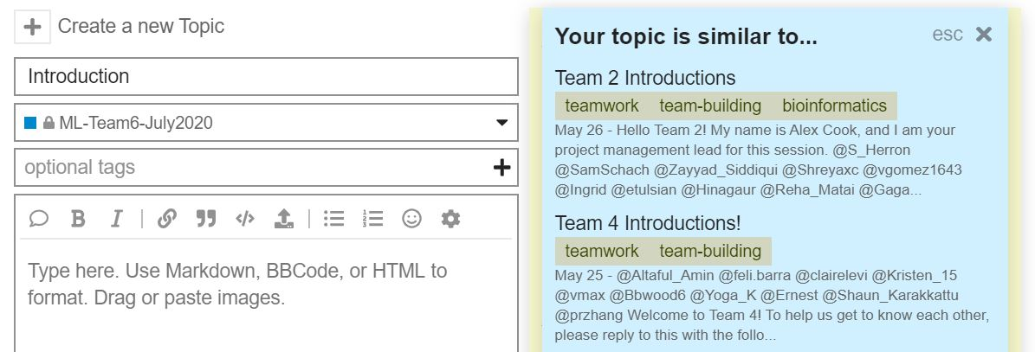
Overview
Team Setup
Data Collection
Data Cleaning
Methods of Data Modeling
Data Modeling
Conclusion

Slide 4
Team Setup

Slide 5

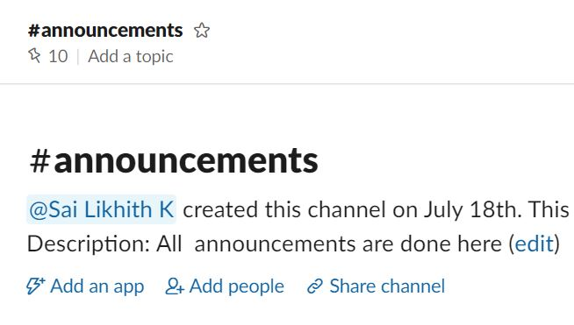

Team Setup – Communication
Goal
Action
01
Establish Team Communications
Set up Slack workspace and invite members
Set up team on Asana and invite members
Create Slack channels for various topics

Slide 6
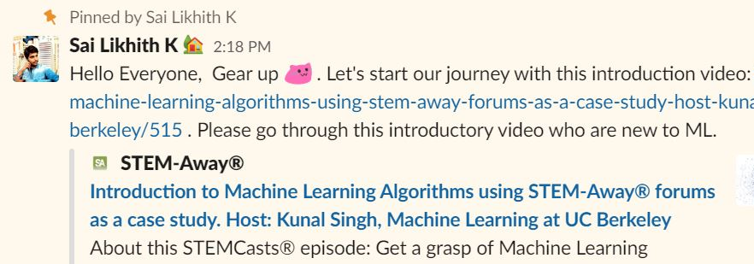


Team Setup – Project Introduction
Goal
Action
02
Get Members Introduced to Project
Send out resources for members to learn about topics
Online articles from towardsdatascience.com
Video Webinars from STEM-Away

Slide 7

Team Setup – Team Building
Goal
Action
03
Begin Team Building
Conduct first meeting with team members
Have everyone introduce themselves
Play games

Slide 8
Data Collection

Slide 9
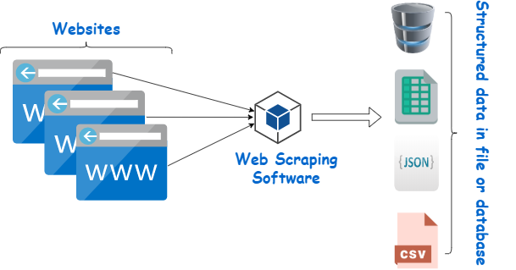
What is Web scraping?

Slide 10


Web Scraping - Libraries
BeautifulSoup - BeautifulSoup is a Python package for parsing HTML and XML documents and used to extract the data from HTML.
Selenium - A driver that is used to control google chrome so as to perform tasks.

Slide 11
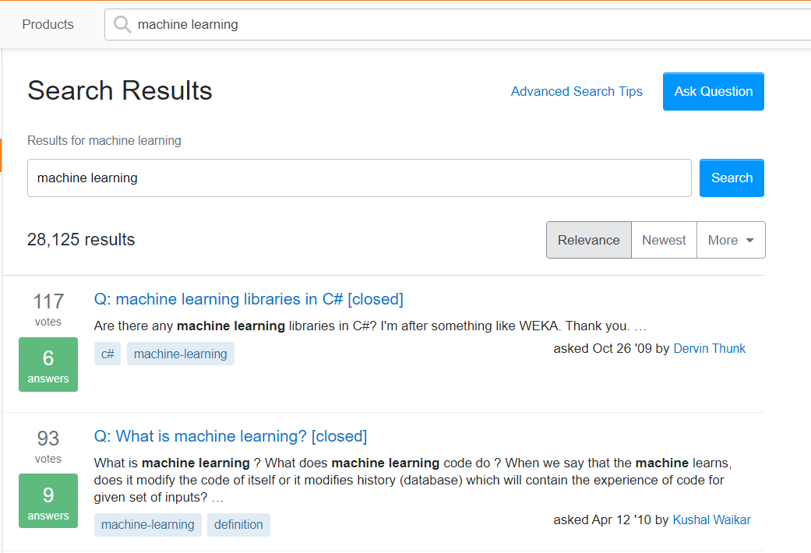
Web Scraping Demo

Slide 12




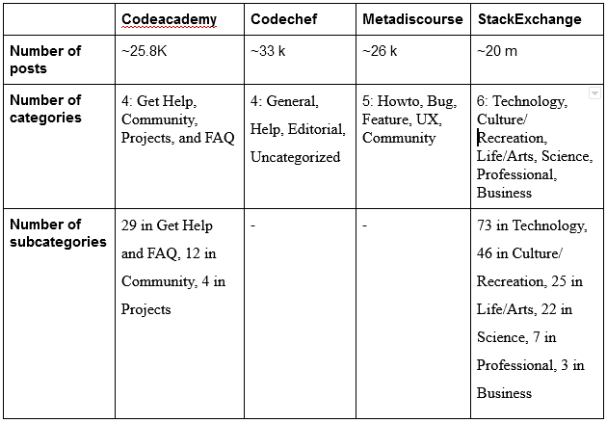
Web Scraping from Different Forums

Slide 13


Rejection of Forums
We started with 4 forums in all namely Stackoverflow, Codechef, Codecademy and Meta Discourse.
Analyzed each forum on many parameters like number of posts, tags, quality of posts and many other parameters.
Some forums got rejected due to the quality of posts like Discourse, some due to the number of posts.
At last we shortlisted Stack Overflow as it satisfied all of the crucial criterias.
Notes:
Started with 4 forums
Divided teams Analyzed factors
Rejection of some forums
Final selection

Slide 14
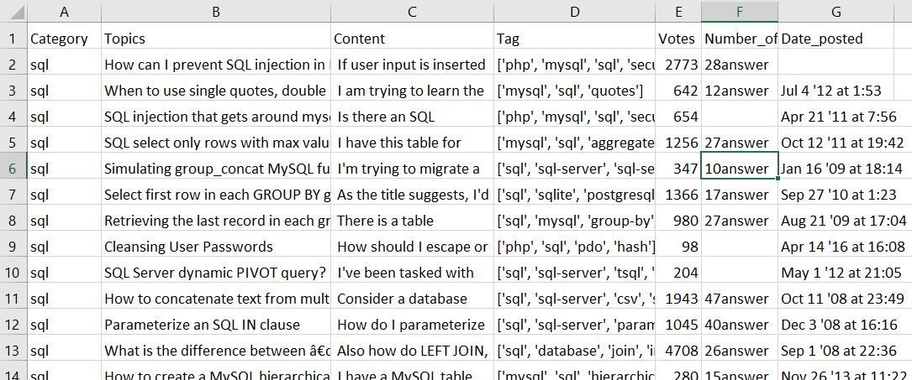
The Actual Data Scraped
The actual data which was scraped had 708,000 rows or topics

Slide 15
Data Cleaning

Slide 16
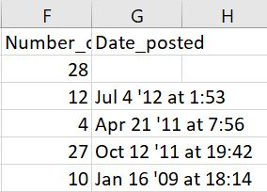
Data Cleaning Steps
Removal of unnecessary columns like Number_of_Answers and Date_posted
Removing all Punctuations
Converting to Lowercase
Removal of Stopwords
Tokenization
Lemmatization
Stemming
Notes:
-

Slide 17
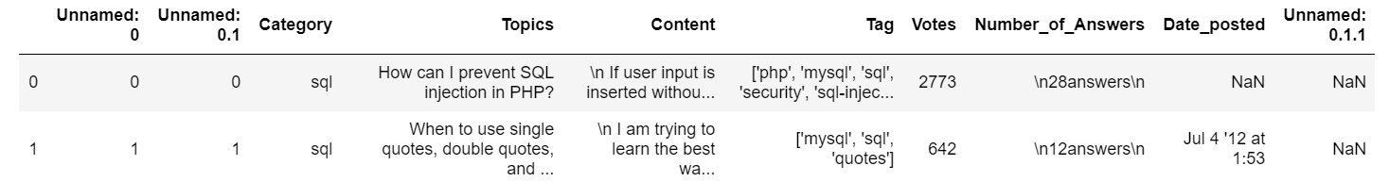
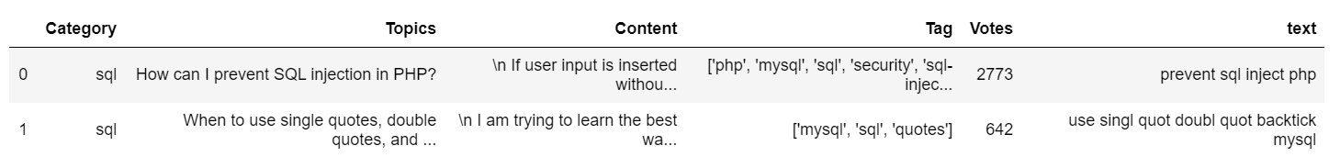
Original dataset
Cleaned Dataset (with stemming)

Slide 18
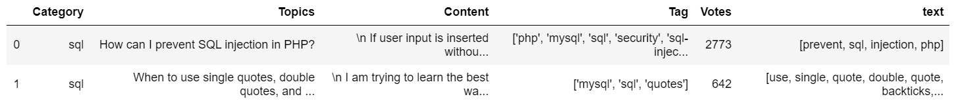
Cleaned Dataset (without stemming)

Slide 19
Methods of Data Modeling
Notes:
Justin

Slide 20
Observations
Our input training data set contained a large amount of words
Our labels were the “topics” column of the data set
While executing the model, we needed to write an input as a sentence where we would then tokenize and extract keywords out of it.
Then, we pass those keywords as inputs and predict the output Topic Name

Slide 21

Data Modeling Methods
BERT - Cutting edge language model for NLP, recently developed by Google
DistilBERT - Compact and faster version of BERT, but lower performance
TF-IDF - Term Frequency-Inverse Document Frequency. “Old fashioned” bag of words
Simple Transformer - Easy to use but lower performance on a larger data sets

Slide 22
Why BERT?
BERT is a pre-trained, only needs one more output layer to be able to solve a wide variety of NLP problems
BERT has been trained on large datasets that allow it to have a deeper understanding of how a language works
Older models have limitations to the amount of data they can take in, making many models too complex and also causing problems like overfitting
Older models don’t take in the context, or even if they do its one sided causing many words with different meanings in different contexts to have the same vector
Notes:
https://www.analyticsvidhya.com/blog/2019/09/demystifying-bert-groundbreaking-nlp-framework/

Slide 23
Data Modeling

Slide 24

BERT
Bidirectional Encoder Representations from Transformers (BERT)
BERT is designed to pre-train deep bidirectional representations from unlabeled text by jointly conditioning on both left and right context in all layers.
We use a pre-trained BERT model checkpoint to build a general-purpose text feature extractor.
Then we use k-NN (k-nearest neighbour) search to find the topics which are most similar to the given query.
We vectorize the topics and use the search engine to find nearest neighbours.
That allows us to build a simple topic recommendation system, which suggests similar topics.

Slide 25
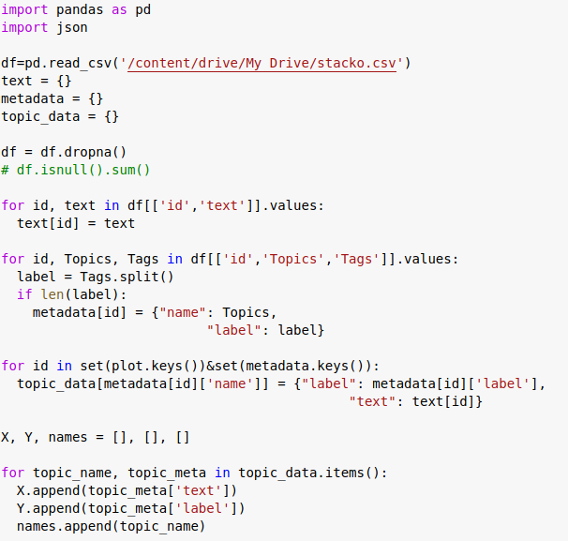
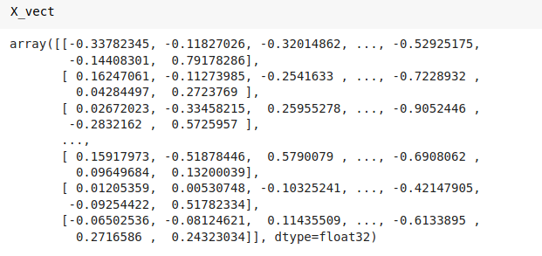
BERT Example

Slide 26
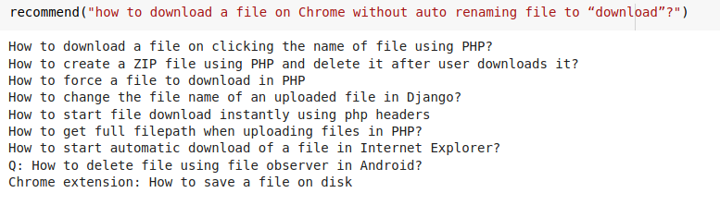
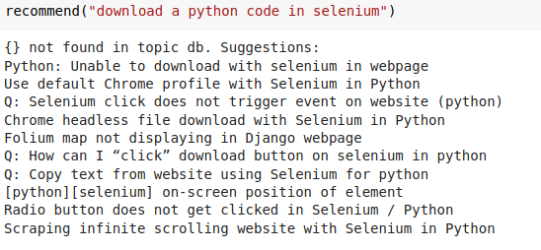
BERT Results
Similar topics are found by calculating euclidean distance of a given query.

Slide 27

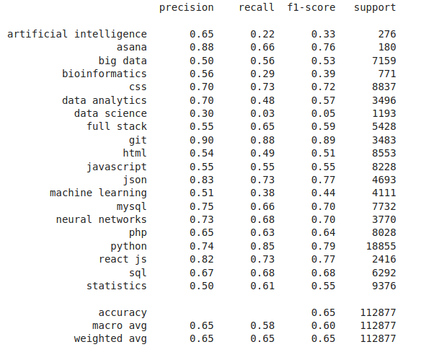
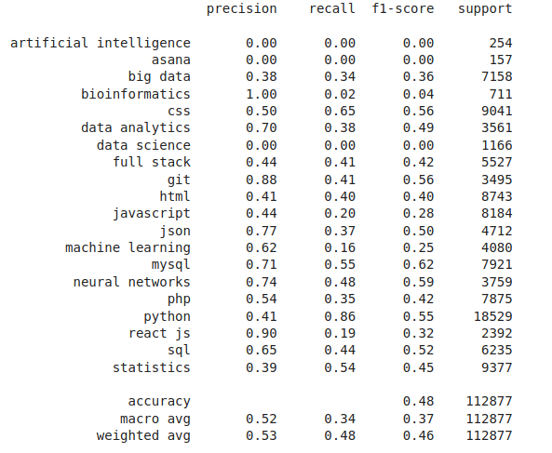
BERT Performance Metrics
Logistic Regression Random Forest Classifier

Slide 28
DistilBERT
“Distilled” version of the BERT model
Smaller
Faster
Less number of parameters
Nearly same performance as BERT
Notes:
Talk quantitatively about the size, speed and performance

Slide 29
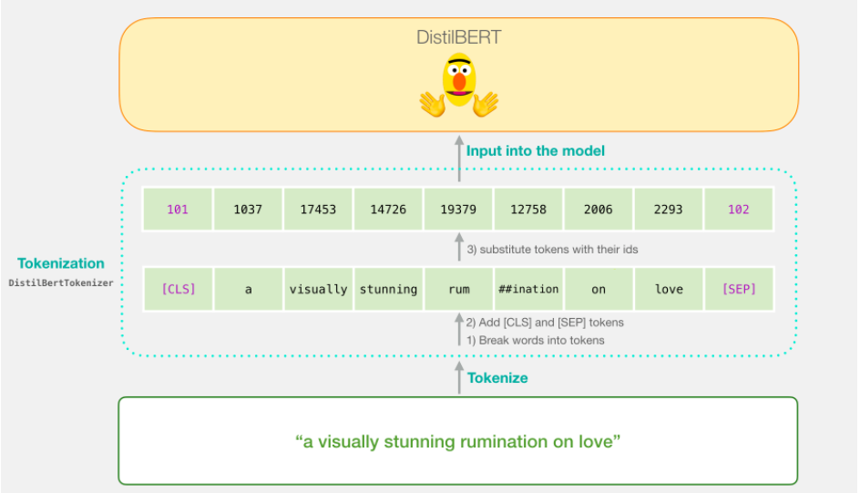
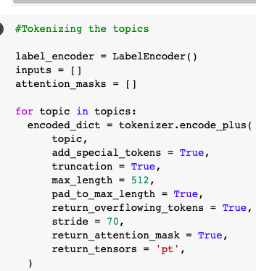
Tokenizer class
What
do
you
mean
by
machine
learning
“What do you mean by machine learning”
Notes:
Explain the working of the class

Slide 30
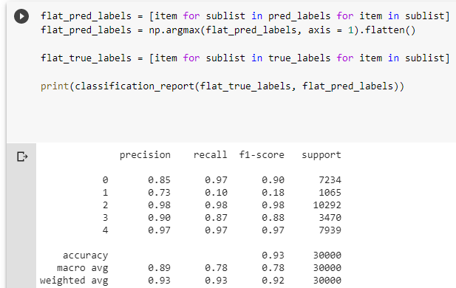
Model Evaluation
The model was trained on 150k rows of the dataset for which it returned an overall accuracy of 93%.
The second row depicts the metrics for the Data Science category. The values are low because it had less content.
Notes:
Train, validate, test division + scope

Slide 31
Conclusion

Slide 32
Takeaways
Successes
We were able to scrap relevant data from four forum sites having 800k+ rows in total.
We performed data cleaning and preprocessing on the dataset as well as removed all the irrelevant columns.
We were able to implement the model using two methods BERT and DistilBERT.
Notes:
4 sites: StackExchange/StackOverflow, Codecademy, CodeChef, MetaDiscourse (ended with StackOverflow)
Preprocessing: removed 100k rows
DistilBERT: 93% accuracy, BERT: 65% accuracy

Slide 33
Takeaways
Challenges
Scraping data from sites with pagination was easy, however for websites with infinite scrolling (eg. Codecademy) it was difficult.
Performing data cleaning on such a large dataset was time consuming (~5hr), especially for lemmatization and stemming.
We had to perform data cleaning again as we found out that stemming was giving inaccurate results for our model.
Training such a large dataset was also not feasible (12+ hours) so we had to train the model in batches, the same problem occurred while applying classification models on it.
Notes:
Infinite scrolling: solved w/ Selenium
Time-consuming: ended up pushing through
Dataset Training time: using DistilBERT helped as well

Slide 34
Takeaways
Future Improvements
Fine tuning BERT by using additional output layers and using Neural Networks to improve the model.
Figuring out methods to handle skewed categories to improve the performance metrics of the model.
Deploying the final version of the model using AWS.
Notes:
Output layers: only using 1 at the moment, just softmax
Skewed categories: Python and HTML categories had the majority of posts, meant that some of the smaller categories didn’t have enough quality posts to become as accurate
Deployment: can work on AWS deployment next, needs to be slightly adapted for a full production environment

